Slide 1

Stock Market Forecasting
By
Group No. 2
Project no P97

Slide 2



The goal here is to make the companies and businesses to understand and analyse the market to lower their expenses and enhance profits along with helping the investors in identifying purchasing and selling patterns by using Modern Data Analytics.
Objective

Slide 3
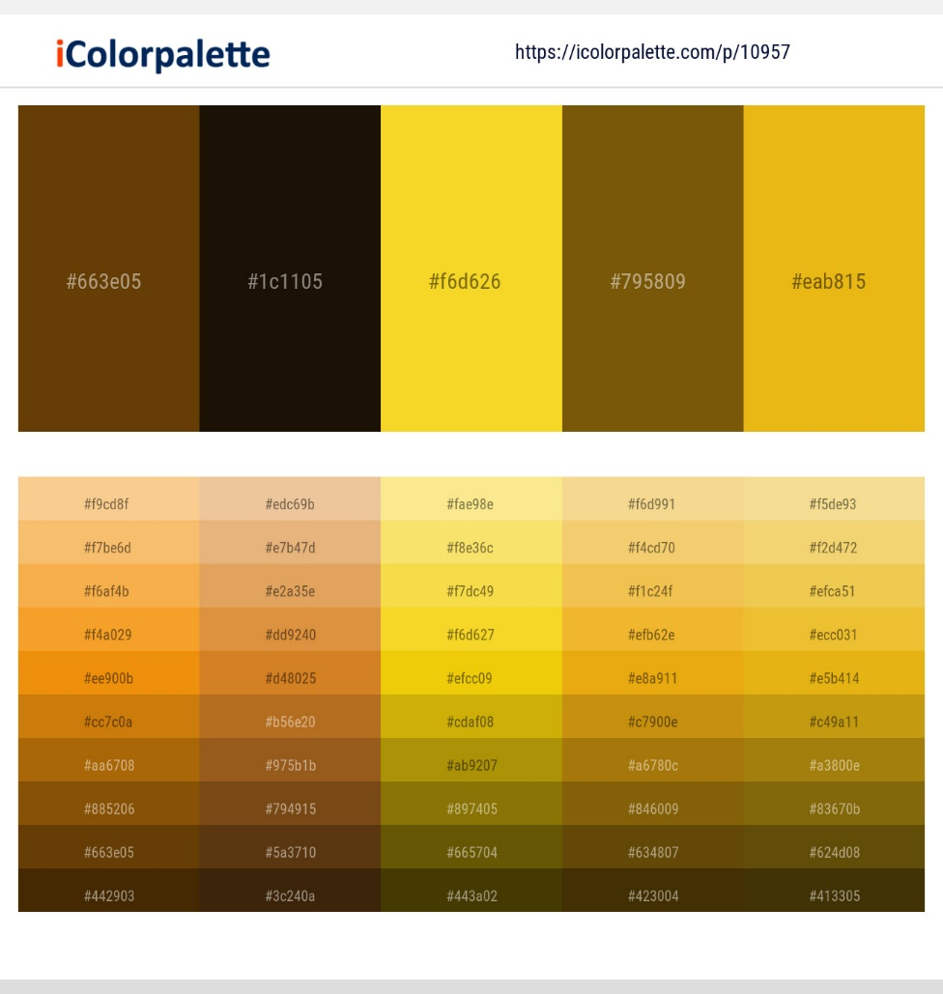
Forecasting is task of predicting future values using statistical and mathematical techniques.
In this Project along with Mathematics and statistics, machine learning and Deep learning is used.
What is Forecasting?

Slide 4
Extract Live data from stock Market
Analyze Data
Build Visualizations
Building Machine learning or Deep learning model
Deploy model,
What we are going to do?

Slide 5
Data Collection
Data Transformation
Visualization
Flow Chart
Model Building
Deployment

Slide 6
Data Collection
For Data Collection, library developed by yahoo finance is used which is know as yfinance.
For this Project, companies listed on Nation Stock Exchange (NSE) will be used and available for forecasting.
For Model Building, 5 years of data of TATA-MOTORS and RELIANCE is extracted.
In final Product, user can select any company listed on NSE and can Forecast using model

Slide 7
Tata Motors stock data
Tata motors data is extracted using yfinance using Symbol = TATAMOTORS.NS
The data is extracted from 08-03-17 to 08-03-22 (5 years)
Date | Open | High | Low | Close | Volume | Dividends | Stock Splits
02-03-22 | 452.95 | 454.25 | 444.55 | 447.6 | 25791134 | 0 | 0
03-03-22 | 458.5 | 458.5 | 435 | 437.1 | 29599672 | 0 | 0
04-03-22 | 431.85 | 431.85 | 414.75 | 417.25 | 38765185 | 0 | 0
07-03-22 | 401.75 | 401.75 | 387.5 | 394 | 44836205 | 0 | 0
08-03-22 | 390.5 | 395.45 | 376.35 | 391.75 | 55526844 | 0 | 0

Slide 8
Reliance stock data
Reliance data is extracted using nsepy using Symbol = RELIANCE
The data is extracted from 02-01-17 to 08-03-22 (5 years)
Date | Symbol | Series | Open | High | Low | Last | Close | VWAP | Volume | Turnover | Trades | Deliverable Volume | %Deliverble
02-03-22 | RELIANCE | EQ | 2334.45 | 2401 | 2329.2 | 2399.25 | 2398.55 | 2376.69 | 9909226 | 2.36E+15 | 309328 | 6277829 | 0.6335
03-03-22 | RELIANCE | EQ | 2400 | 2414.85 | 2370.05 | 2382 | 2378.3 | 2392.27 | 4701183 | 1.12E+15 | 230143 | 2479449 | 0.5274
04-03-22 | RELIANCE | EQ | 2353 | 2364.3 | 2320.35 | 2327.95 | 2325.55 | 2338.2 | 4986814 | 1.17E+15 | 219860 | 2754095 | 0.5523
07-03-22 | RELIANCE | EQ | 2278.7 | 2312.1 | 2222 | 2240.05 | 2239.55 | 2256.84 | 8299295 | 1.87E+15 | 372828 | 4962748 | 0.598
08-03-22 | RELIANCE | EQ | 2211.5 | 2246 | 2180 | 2235.05 | 2235.5 | 2220.15 | 9825043 | 2.18E+15 | 428117 | 5602260 | 0.5702

Slide 9
It consists of Data Cleaning, Data Analysis and Visualization
Data Cleaning consist on changing data types of features/ Columns
Data Analysis and Visualization is used to get some more insides about data and find relations between features.
Data Exploration

Slide 10
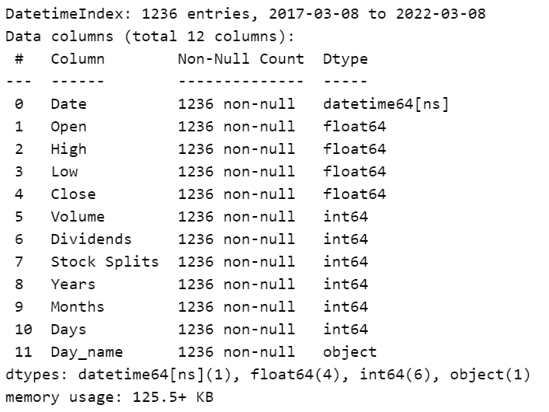
Data Exploration
There are no Null values in dataset
The Dataset is also clear from any mixing dtype in columns
Only if data is saved in csv and then loaded again, ‘Date’ column datatype will be changed to object.
Some extra columns are created to explore data like months, Years etc.
Fig shows detail of data of Tata-motors.

Slide 11
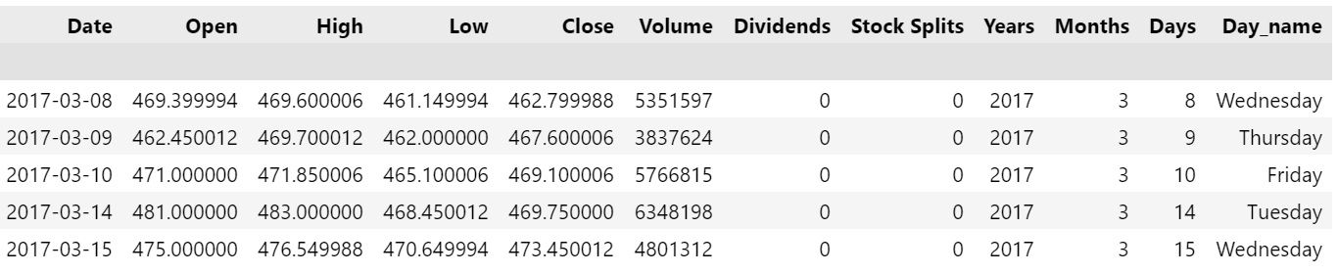
Dataset after cleaning
After exploring we get following insides from TataMotors.
52week High value = 536.7
52week Low value = 268.45
Total number on holidays = 591 (in 5 years)

Slide 12
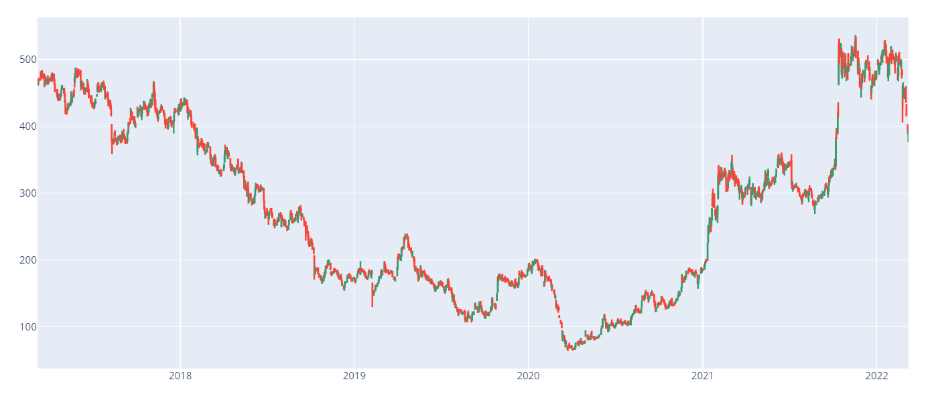
Candle plot

Slide 13
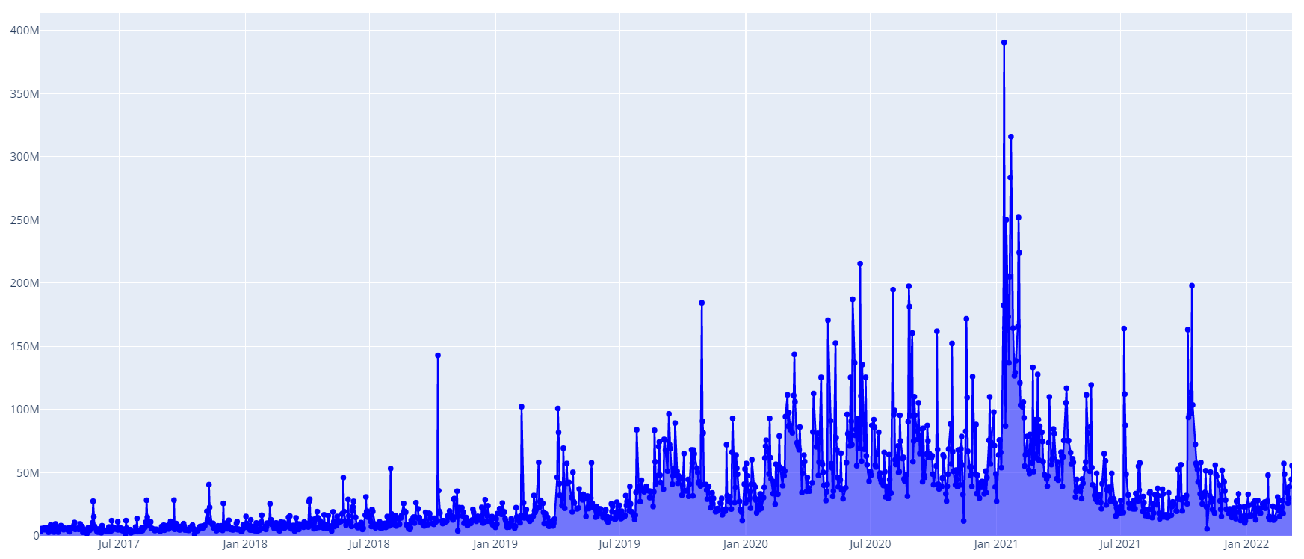
Volume plot

Slide 14

The most important points is that, the sudden rise or fall of in stock can be represented by exceptionally high volume.
The stock has been more active in covid period, because many peoples was free and started trading.
In period of 2020-2021, there are many large volume trade and hence represented by rise or fall in candle plot.
Insides from Candle and Volume plot

Slide 15
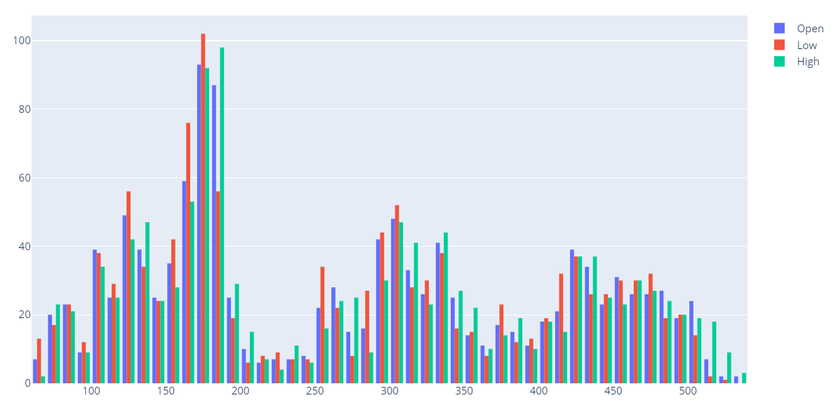
Histogram for distribution
Histogram show the distribution of stock price.
Stock attained 150-200 price range more time than other. (Tata Motors)

Slide 16
The most important point is that the stock price is affected by volume, so it can help in model building
After trying some transformations like log, sqrt and box-cox, there is no considerable effect on data.
Covid period change is clearly visible in plots
Important information from visualization

Slide 17
The data transformation is necessary step in model building.
For Model building, some models like LSTM, RNN etc. need sequential data, Which needs to be created.
Models like ARIMA, SARIMA etc. there is no need to create data, these models can be training without any data manipulation.
Data Transformation and Data Creation

Slide 18
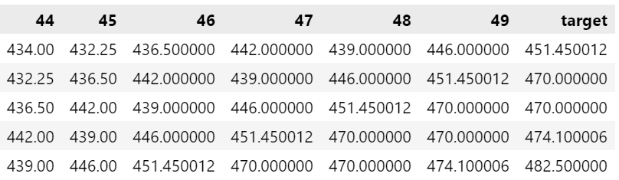
Data Creating for LSTM
For Sequential models like LSTM, data must be in sequence form with next number as target variable.
For LSTM, the data is created with 50 time steps as past and next time steps is preserved as target.
Following table shows last 5 time steps (total 50 time steps and 0 as first) and target value.

Slide 19
About Data Created
Different types of data created either by using ‘Open’ or ‘Volume’ or Both as Independent and also Dependent (Univariate and Multi-variate)
Along with single target value, multiple target value dataset is also created.
Following table shows information about datasets created for LSTM
Name | Independent variable | Target Variable | No of targets | Shape
Mean_value_dataset | Open | Open | 1 | 1185 x 51
Day_combo_data | Open, Volume | Open | 1 | 1185 x 50 x 2 and 1185 x 1
Combo_dataset_2 | Open, Volume | Open, Volume | 1 | 1185 x 50 x 2 and 1185 x 1 x 2
Open_dataset_multi | Open | Open | 10 | 1156 x 70 x 1 and 1156 x 10
Open_dataset_multi_target | Open, Volume | Open, Volume | 10 | 1146 x 80 x 2 and 1146 x 10 x 2

Slide 20
Data split and Data Transformation
The Created data is then divided into 3 parts with 70%, 15% and15% for training, validation and testing for LSTM.
For models like ARIMA, SARIMA, 2 splits are used one for training and other for testing
After splitting, MinMax Scaler is used to scale data in the range of (0, 1)
MinMax Scaler Is fitted on training data and then applied to other to avoid data leakage.

Slide 21
Let’s Discuss ARIMA and SARIMA model

Slide 22
This PPT includes LSTM models and GRU model.
There are different variations of LSTM models that are used like Bi-Directional and Stacked LSTM along with Dense layer.
For LSTM, Tensorflow library is used.
Model Building

Slide 23
LSTM model
Different varieties of LSTM models are tried with different datasets
LSTM model with:
Single layer
Multiple layer
Single layer of BiDirectional
Multiple layers of Bi-Directional
Single dense layer
Multiple Dense layers
Are tried and trained on different datasets.

Slide 24
Multivariate LSTM model multi-target
This model is pretty much complex to interpret and understand, because of complex dataset and its Three dimension shape.
In this model both Open and Volume are target variables with multiple values.
This model is considerably powerful than others and also gives good accuracy and reliable forecast.
This model consist of LSTM, two bidirectional LSTM and 4 dense layers in group of 2 for two targets
Next slides shows the model plot.

Slide 25
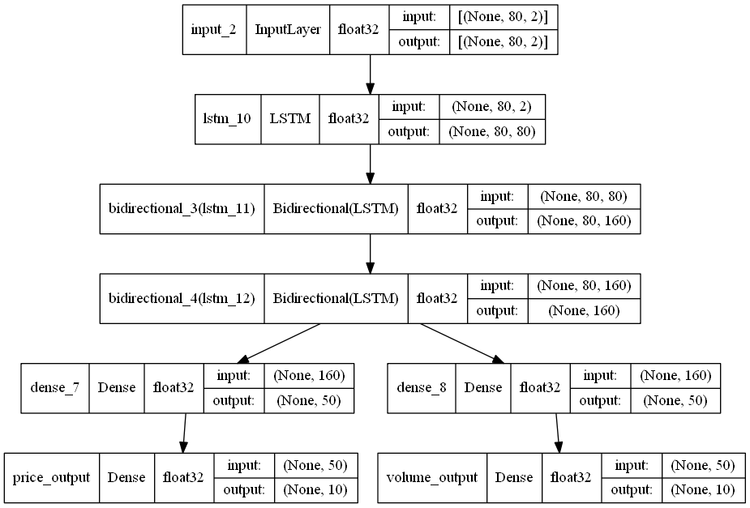
Multivariate LSTM model multi-target
(Plot)

Slide 26
Deployment Model
Previous model, is powerful but complex and tricky, so it is not used for deployment.
Final Model is Created using univariate data and it consists of:
Two Bi-directional LSTM (50 layers)
One GRU (50 layers)
2 Dense layers (25 and 1)
Data Consists of 50 time steps and total 1185 rows.
Model is trained for 100 epochs.

Slide 27
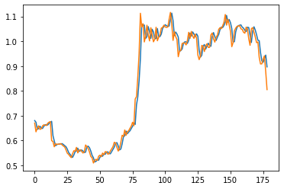
Final Model Accuracy
Model selected for deployment, offered following accuracies:
Plot shows testing data curve and model predicted curve (orange line is actual)
Dataset | Shape | Accuracy (MSE and MAE)
Training | 829 x 50 x 1 | 2.67e-4 and 0.0118
Validation dataset | 177 x 50 x 1 | 4.38e-4 and 0.0142
Testing dataset | 179 x 50 x 1 | 1.00e-3 and 0.0206

Slide 28
To build best model for foresting, more data is needed.
Univariate model is selected as final for deployment because of its simplicity and good accuracy.
The model is trained on TATAMOTORS data and will be fine tuned on respective company data.
Weights of the model are saved for deployment
Result from model building

Slide 29
For deployment, purpose streamlit library is used because of its simplicity and easy to understand.
In deployment, user will be allowed to select any company provided.
User can get forecast of selected company using fine-tunning of LSTM model.
Deployment

Slide 30
User Interface
The List of companies will be provided in the form of drop-down menu and user can select any company from it.
The period selection drop-down menu is provided to select period of data, that is day wise or minute wise.
User also can select interval for data, ranging from 1 year to 10 years.
There are two plots, one candle plot and other is volume plot.
For forecasting, there is a button, if user wants forecast then press button and model will forecast data.

Slide 31
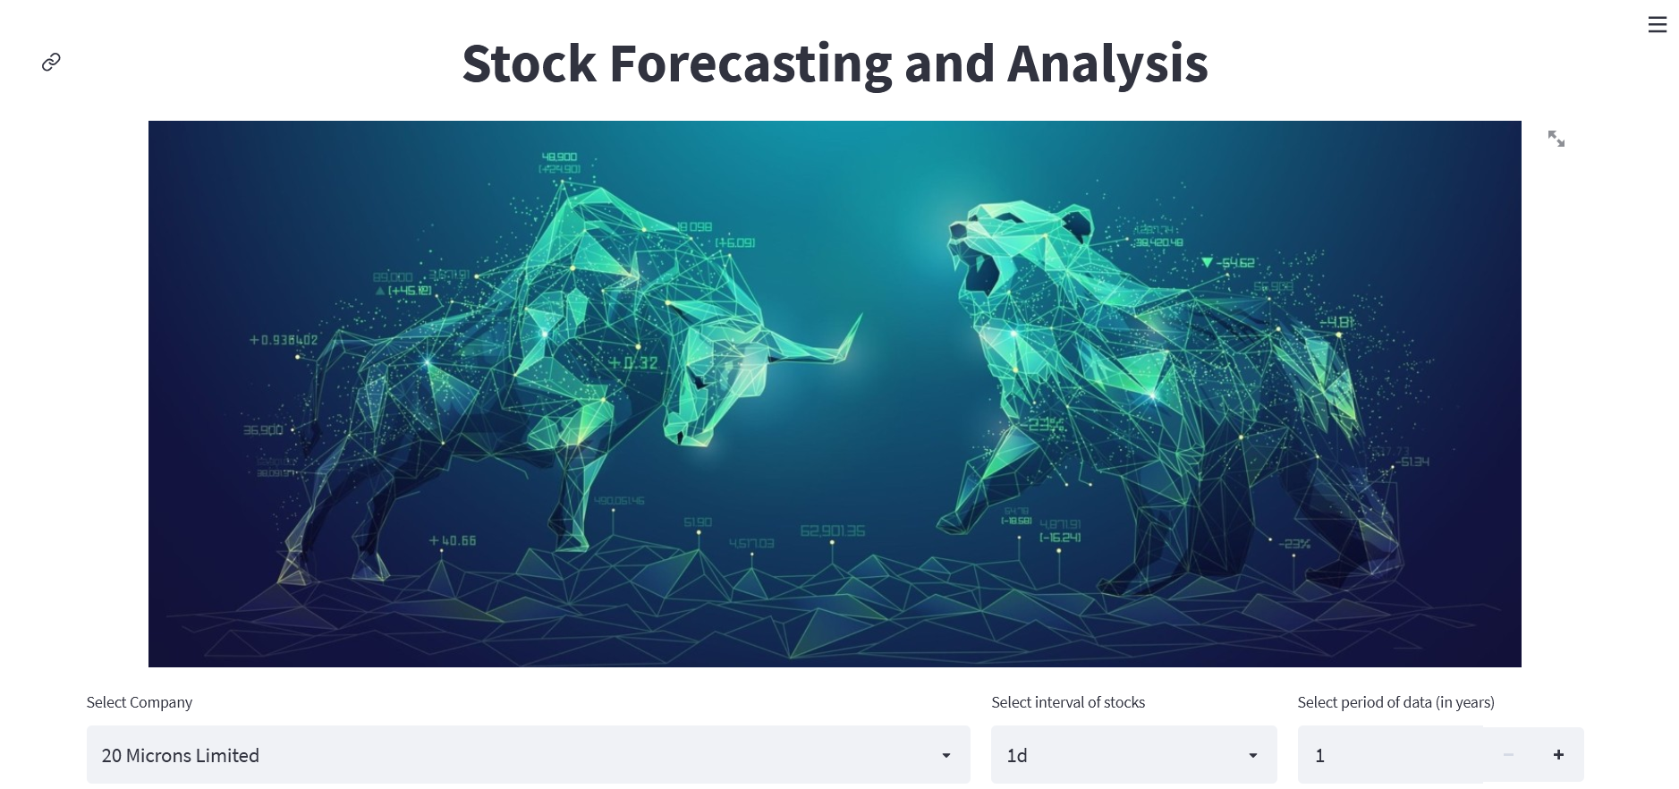

Slide 32
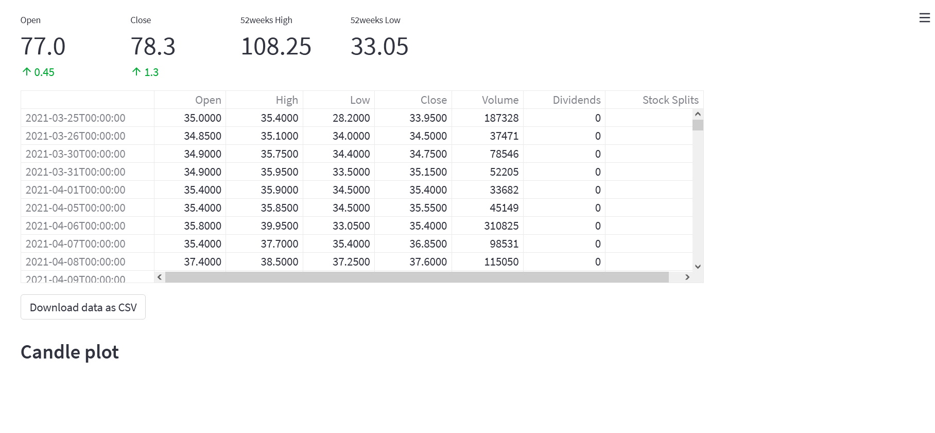

Slide 33
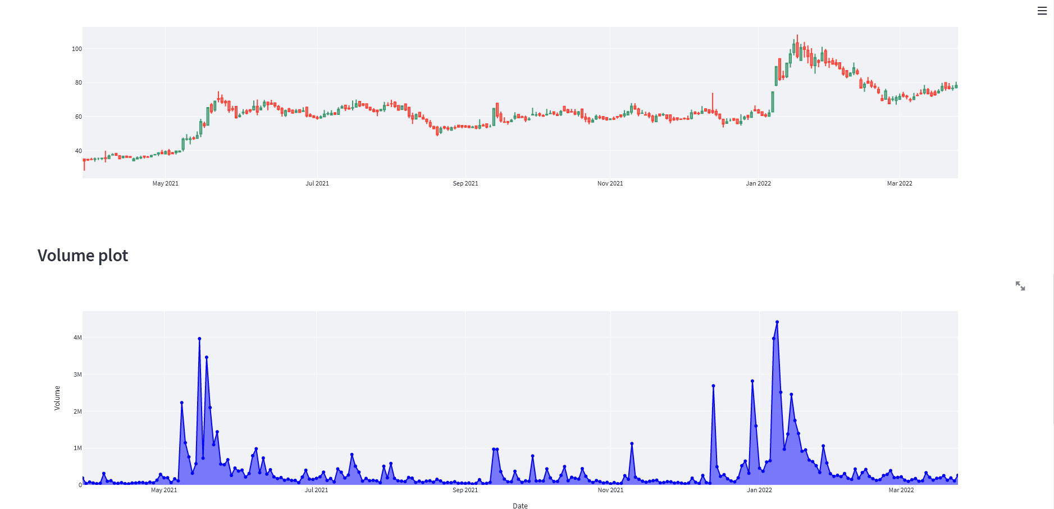

Slide 34
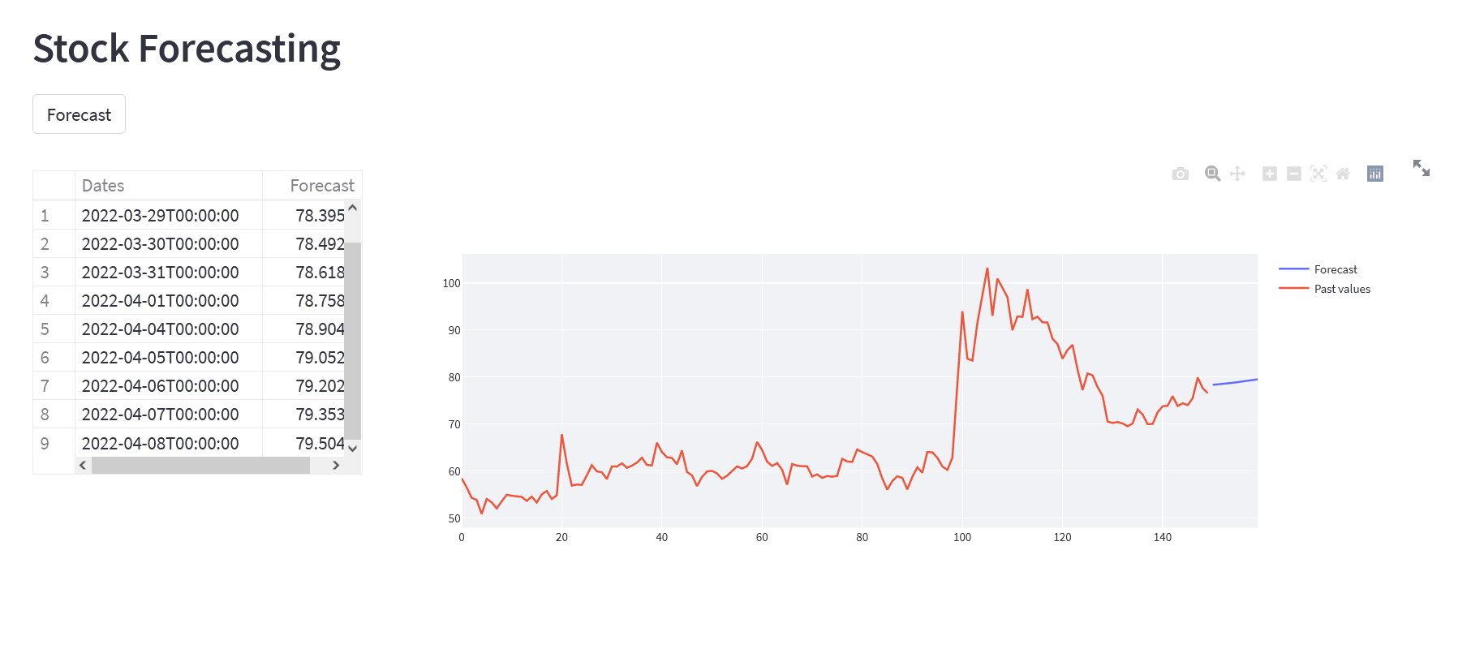

Slide 35



Thank you

